Slide 1
Curriculam of the
Graduate School of
Advanced Science and
Engineering (AdSE)
Hiroshima University

Slide 2
Purpose of the Guidance
・Understand how to Graduate
１．Rules of credits
２．Research Instruction and Thesis
３．Others (Research Ethic)
Please prepare Student Handbook
Where to see is different between Master’s Course and Doctoral Course.
M＝Master’s Course
D＝Doctoral Course
Notes:
Please read this document after you received student ID card and student handbook from the student support office.
The purpose of this guidance is to help new students understand how to complete the Program and get degree. It is mainly about 1. “Credits” , 2. “Thesis“ and 3. Others “Research Ethic”. If you couldn’t understand the explanation, do not leave it and ask questions to your supervisor or your program support office (PPT page 8). "Student Handbook" (English version) , you’ll receive it from student support office. The pages to be viewed are different whether you are master’s or doctoral course student. It’s described as pages M〇 and D〇 on the PPT.

Slide 3
How to Graduate
Student Handbook Page M19~ D81~
To complete your master’s (or Doctoral) course, you need to earn 30 (16 for Doctoral) or more credits based on the following requirements, receive necessary research guidance, and pass the master’s (Doctoral) thesis screening and the final examination.
Notes:
Now I will explain the requirements for completing the program. Please open the page “Class subjects and Registration” which you belong (page19~ for Master’s course, page81~ for Doctoral course). The table on that page and the requirements for completing the course are described in “Registration Method and Completion Requirements" which is placed below the table. As it written, “To complete your Master’s (or Doctoral) course, you need to earn 30 (16 for Doctoral) or more credits based on the following requirements, receive necessary research guidance, and pass the Master’s (Doctoral) thesis screening and the final examination.(Omission)

Slide 4
１．Rules of Credits
3 Subject Type
(1) Common Graduate Courses：
For all HU Graduate students
(2) Common Subjects
for the Graduate School：
For all AdSE Graduate students
(3) Subjects Specialized for the Program
Subjects for the program you belong
Notes:
Rules of Credits. Please look at the table of your program.
All subjects are separated into 3 types. (1) Common Graduate Courses, (2) Common Subjects for the Graduate School, (3) Subjects Specialized for the Program. Target students are different depending on subject types.
Common Graduate Courses are for all HU Graduate students (including Graduate School of Humanities and Social Sciences, Graduate School of Integrated Sciences for Life etc.). This subject type is separated into “Sustainable Development Courses” and “Career Development and Data Literacy Courses.” It is necessary to get 1 credit or more on each type.
Information is written on (M P51, D P96). There are video explaining about Common Graduate Courses, so please watch it on AdSE’s orientation website.
(2) Common Subjects for the Graduate School are written below (1). This is for all AdSE Graduate students. This is also separated into ”Internationalism (More than 1 credit)” and “Sociality (More than (2 for M, 1 for D) credit(s)”
Information is written on (M P52, D P97)
(3) Subjects Specialized for the Program, are specialized subjects related to the program you belong.
In order to graduate, you have to get the credit as it written on the “Class Subjects and Registration”.

Slide 5
１．Rules of Credits
(3) Subjects Specialized for the Program
・（Only for Master’s students） Subjects Specialized for other program
(take 2 or more credits).
→ Search Syllabus
・ (Only for Master’s students） M P62
Joint Seminars
Notes:
(3) Subjects Specialized for the Program will be your main subjects. Please discuss with your supervisor which subject to take. Don’t forget to get credit of all compulsory subject.
Please look at “Registration Method and Completion Requirements” (3), it is placed under the table. As it written, all AdSE students have to take 2 or more credits on “Subjects Specialized for Other Program.” If you want to search for this subject, may be its good to use “Course Level” written on syllabus. All subjects of HU has a course level, so set course level to “5: Graduate Basic.” Basic course of the program will be . If you obtain approval from your supervisor, it is possible to include other Graduate School’s specialized subject.
Please check Page 62. In Hiroshima University, there are many seminars. If you participated in a total of 15 joint seminars, it will be counted as subject “Joint Exercises in Advanced Science and Engineering Transdisciplinary”. Student of the program “Transdisciplinary Science and Engineering” will be counted as “Subjects Specialized for the Program”. Other program’s student will be counted as “Subject Specialized for Other Programs”.

Slide 6
２．Research Instruction and thesis
Completion schedule（M p63, D p104)
Thesis screening and Final Examination（M p66）
Decision Criteria and Evaluation Standards (M p67, D p119）
Requirements for Awarding Degrees and Criteria for Applying for Degrees（D p120~）
(Important）Submission of “Notification of the Research Title”
Deadline: April 18th
Where: Submit to the Student Support office of your program
Notes:
Next, I will explain Research Instruction and Thesis. Please check page 63 for the Master’s courses and page 104 for the Doctoral courses for the completion schedule. The student support office will contact you at a specific time, so please always check messages on “Momiji" and emails from each program.
I will not give a detailed explanation, please refer to the following pages in the Student Handbook. “Thesis Screening and Final Examination” for Master’s course is listed on page 65. “Decision Criteria for Awarding Degrees and Evaluation standards for Degree Thesis” for Master’s course is listed on page 67 and for Doctoral course is on page 119. Please read it at least once.
・ Conditions for master's thesis (if any) ・ Conditions for doctoral dissertation (If each program has its own rules, please explain briefly based on the handbook page.) (Important) As described in the completion schedule on page 63 for M and page 104 for D, all newly enrolled students are required to submit a “Notification of the Research Title". A sheet of "Notification of the Research Title“ is in the bag, consulting with your academic supervisor and submit it to the Student Support Office by April 18, 2025. You can download “Notification of the Research Title” from the website of AdSE.

Slide 7
３．Research Ethics
Student Handbook on page 12
（Important）Mandatory to take
Research Ethics – Basic
→ Exempt: Doctoral students who have already taken it while enrolled in Master’s course.
Research Ethics - Advanced（M）
Research Ethics - Advanced（D）
Notes:
Finally, I will explain Research Ethics Education. Please open page 12 of Student handbook. Those engaged in research activities at Hiroshima University are required to attend the Research Ethics Education. Graduate students are required to take (1) "Research Ethics Education - Basic" and (2) "Research Ethics Education - Advanced (M) (D)". Research Ethics Education - Basic will be provided through Hirodai moodle(on-demand type), so please make sure to take this Basic. Master’s students must take the Basic (we will check the attendance) . Doctoral students who have already taken the Basic while enrolled in Master’s course, you are exempt from taking it again.
Research Ethics Education - Advanced will be conducted in each laboratory before the start of writing a thesis, so please follow the instructions in each program or laboratory. The student support office keeps your record of attendance for both so please be sure to take the courses as specified. When applying for joint research with another institution, you may be required to submit a certificate as to whether or not you have taken the Research Ethics Education at Hiroshima University. In that case, you cannot issue the certificate unless you have taken the Research Ethics Education - Advanced.

Slide 8
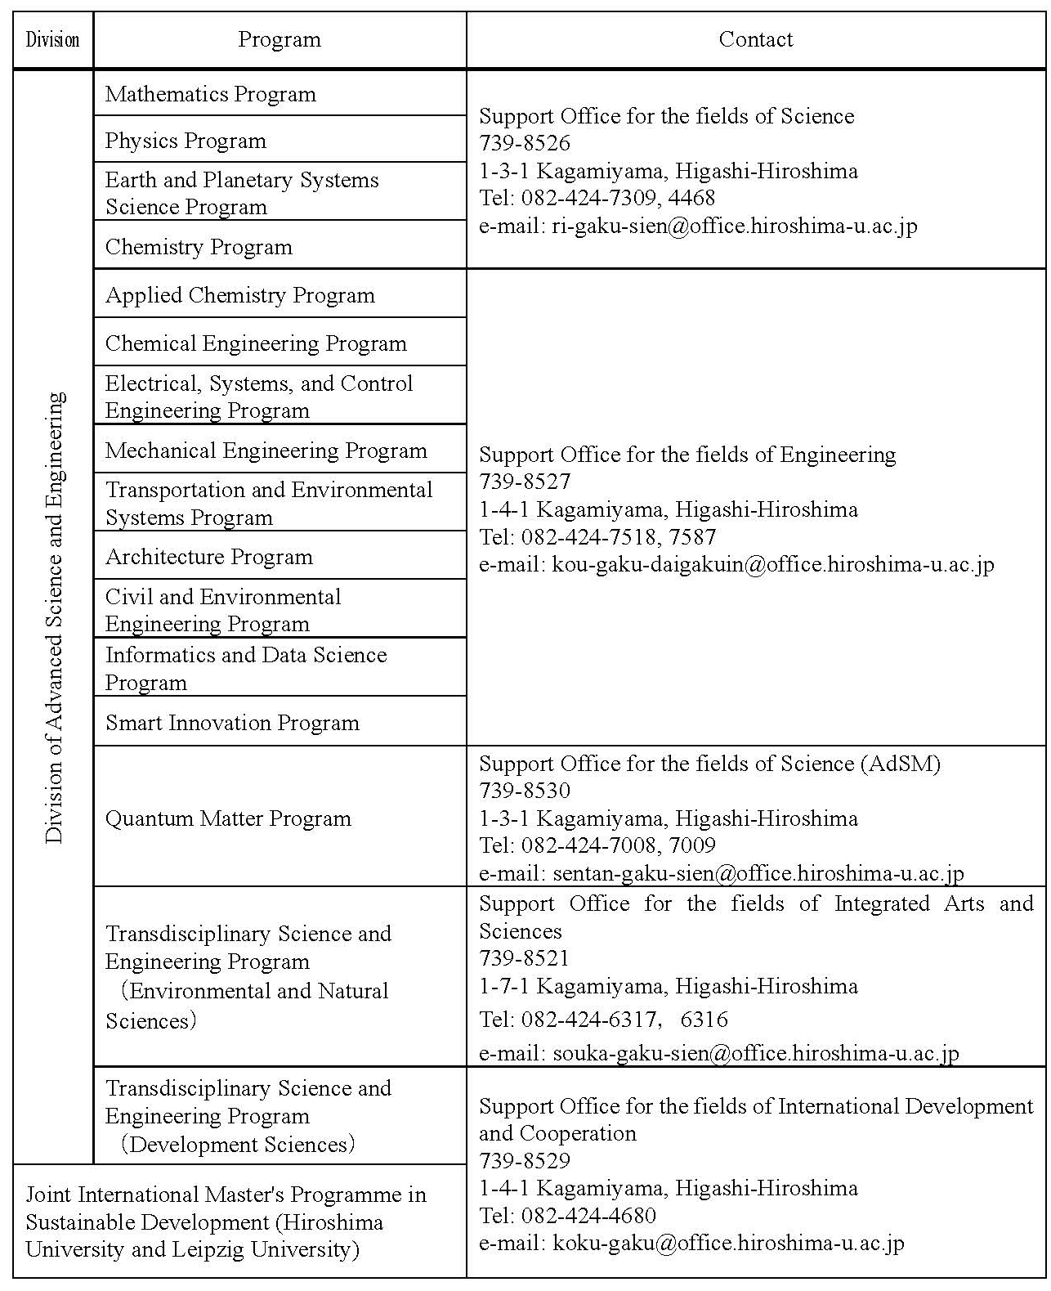
Notes:
This concludes the explanation of the curriculum, but as I mentioned at the beginning, if you have any questions, be sure to check with each program support office or academic supervisor. The student support office of each program is listed on page 143.

Slide 9
Guidance about Curriculum
Fin.
Notes:
Guidance about curriculum if finished.

Slide 10
Important Information
Please prepare
Student ID card (Brown envelope)
”Campus Life Guide at HU”
“Student handbook”
Notes:
Next, I will explain important information. Please have your student ID card, Campus life guide at HU, and Student handbook which you received at the reception.
You can download “Campus Life Guide at HU” from the website of AdSE.

Slide 11
Student ID card and
Password
（Important）
Please sign the receipt and submit to the office.
You can not use your student ID card till we register the receipt.
Notes:
After you received your student ID card from the student support office, please submit 受領書「receipt」 to them. Student support office have to activate your student ID card using the receipt.

Slide 12
Campus Life Guide at HU
（Page 11）
Student Information Portal「MOMIJI」
→ ① MOMIJI Top（Open）
→ ② My MOMIJI（Password）
(Important）Course Registration
Deadline：April 14th
“Common Graduate Courses”
→ register by April 8th
Notes:
Please open page 11 of the Campus Life Guide at HU. " MOMIJI” is the Hiroshima University portal that puts together information for HU students. MOMIJI comprises a top page ① which can be viewed by anyone, and My MOMIJI ② where HU students who log in with their student number on their student ID card and HU password. You can check course registration and grades.
① MOMIJI Top page: There is a lot of information necessary for student life at HU
② My MOMIJI: In order to log in to "My MOMIJI", you will need your student number and password. The login method is as described on page 12 of the Campus Life Guide, so be sure to check it. You should consult with your academic supervisor, and register for the course by April 14th.
There is a manual for the operation method after logging in, but if you are unsure, please contact the student support office of each program.
For “Common Graduate Courses”, a lottery will be held for the subject for which a large number of students wish to register. Please note that you must complete register for the course by April 8th in order to receive the lottery.

Slide 13
Campus Life Guide at HU
What to do when…？（P iii）
Administrative Formalities (P37)
Advise and Counseling (P43)
Notes:
The Campus Life Guide contains various information useful for student life at Hiroshima University, so not only students from other universities, but also newly enrolled students should read it once.
For example, on page iii of Roman numerals, there is a guide for "What to do when....?", On page 37 and after, “Administrative Formalities” in case you want to your student status (e.g. Study abroad, leave of absence, etc.);
On page 43, “Advice and Counseling” there is a consultation desk in case of trouble. ..

Slide 14
Campus Life Guide at HU
Insurance（P58）
Gakkensai (Personal Accident Insurance)
“Comprehensive insurance for International Students” (Inbound Futai-gakuso)
Notes:
Next, I will explain about “Insurance” on page 58. 1. Personal Accident Insurance for Students Pursuing Education and Research (PAS/”Gakkensai”) and 2. Comprehensive Insurance for Student Lives coupled with PAS/”Gakkensai” for International Students.
“Gakkensai” is the insurance for injuries incurred during classes and events, commuting and traveling bet. University facilities. All Hiroshima University students are covered by “Gakkensai” with the university paying it for you, so you do not need to subscribe to this insurance plan.
“Comprehensive insurance for Student Lives coupled with PAS/”Gakkensai” for International Students” (Inbound Futai-gakuso) is Liability Insurance which covers for injuries incurred to others and/or damage to others’ properties. At Hiroshima University, all international students are required to subscribe to this insurance plan so that their student life in Japan will be protected.

Slide 15
Economical Support
Scholarships for Privately-Funded international student (P54)
Tuition fee Exemption（P55)
“Momiji Top” →”Campus Life Information” →” Economical Support”
Notes:
Information about scholarships is posted on Momiji. For private founded international student, the student support office will send you scholarship information from private organizations. So if you have any questions about scholarships, please ask the student support office.
If you want to apply for tuition fee exemption, please check P55 or Momiji Top.

Slide 16
AdSE Economical Support
‣ For doctoral students (36 months)
‣ Support for the amount equivalent
to the tuition fee
Please submit the invoice to the office of your program by April 18th.
There is also an incentive system for devoting yourself to research, such as the Hiroshima University Graduate School Research Fellowship.
Notes:
For the doctoral course students, there is an economic support system of AdSE, “Research Scholarship for Doctoral Students of the Graduate School of Advanced Science and Engineering,” which supports the amount equivalent to the tuition fee. All doctoral students are required to submit the invoice. Those who are eligible will be notified through ”My Momiji”. Please be sure to confirm your eligibility and submit it to the office of your program by April 18th.
In addition, HU has research incentive programs. For details, please see the website of Career Counseling for Doctorate Students and Young Researchers of Global Career Design Center.

Slide 17
Others
Commute by car (P42)
MOMIJI top → Campus Life Information → Guidance Procedures → Application procedure for parking permit
*Attendance at a traffic safety course is mandatory
Commute by Bicycle
Please contact the student support office.
Notes:
If you want to commute by car, you need to apply the permit from MOMIJI Top. Please check page “ Application procedure for parking permit”
If you want to commute by bicycle, you need to register your bicycle. Please contact the student support office.

Slide 18
Others
Please make it a habit to regularly check "Momiji Top" and "My Momiji".
*Be sure to check “My Momiji” daily.
Please check the syllabus for individual classes.
Notes:
Various information is updated on a daily basis.
Please make it a habit to visit "Momiji Top" and "My Momiji" on a regular basis.
If you miss any information, you are responsible for it.
Please be careful not to forget to check the Momiji Message board. Any disadvantage caused by not checking the Momiji Message board is your responsibility.
Please check the syllabus for individual classes.

Slide 19
Fin

